Slide 1

Science Island
Research Report on Curriculum Mapping Software
Project code: SC
Team Redback
Jiayi Li 1097419
Zuguang Tong 1273868
Yiqing Ding 1113840
Haorun Yang 1067299
Jiafu Zhang 1184772

Slide 2
Agenda
Part 2
Requirement Analysis (User stories)
System User Analysis (Personas)
Motivational Model (Who-Do-Be-Feel)
Part 1
Mechanism of Mapping Curriculum
Science Island Mapping Logic
Other Mapping Software Examples
Science Island Mapping Software Prototype
Assignment Section Extension

Slide 3

Mechanism of Mapping Curriculum
Part 1

Slide 4
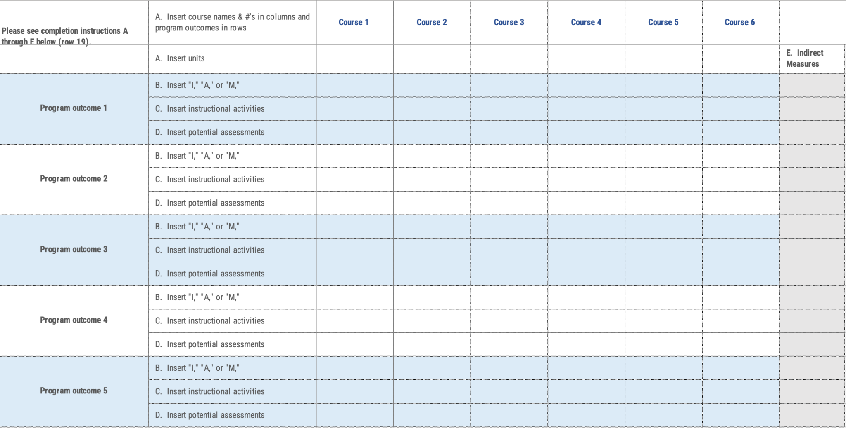
CMU Mapping Tool
Level of knowledge/skills to be demonstrated
I: Introductory
A: Advanced
M: Mastery
i.e. case-study, project, debate, group work, lab, lecture, presentation, essay exam etc.,
Learning outcome (achieved by SC activities )
Source: Carnegie Mellon University, “Curriculum Mapping Tool - Eberly Center - Carnegie Mellon University,” Cmu.edu, 2021. https://www.cmu.edu/teaching/assessment/assessprogram/tools/Curriculum%20Mapping%20Tool.html.

Slide 5
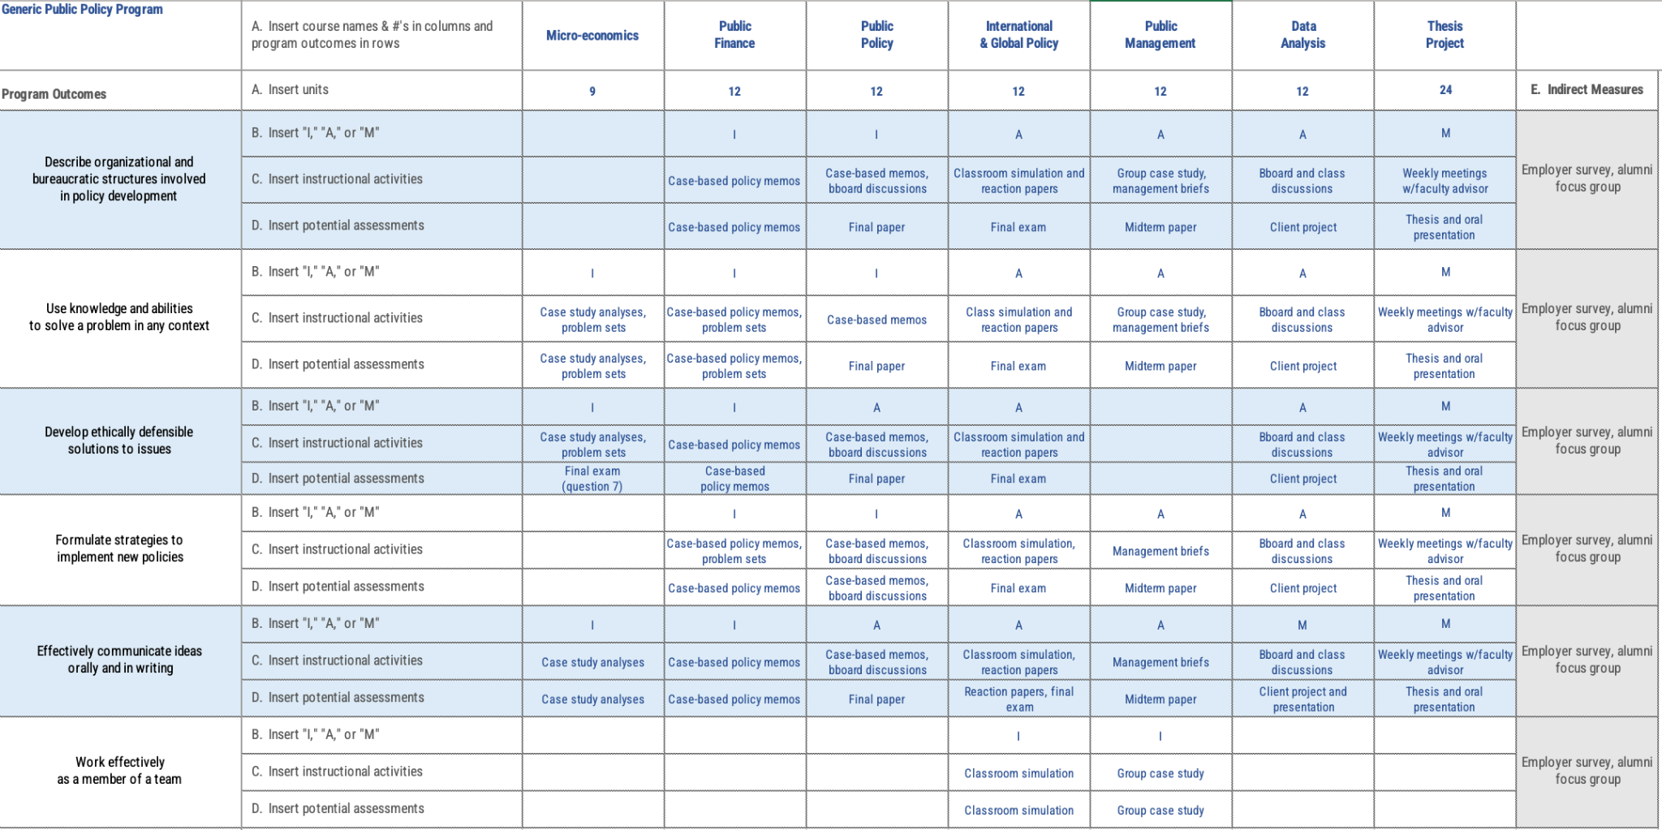
CMU Mapping Tool
There may be other more suitable tools!
Source: Carnegie Mellon University, “Curriculum Mapping Tool - Eberly Center - Carnegie Mellon University,” Cmu.edu, 2021. https://www.cmu.edu/teaching/assessment/assessprogram/tools/Curriculum%20Mapping%20Tool.html.

Slide 6
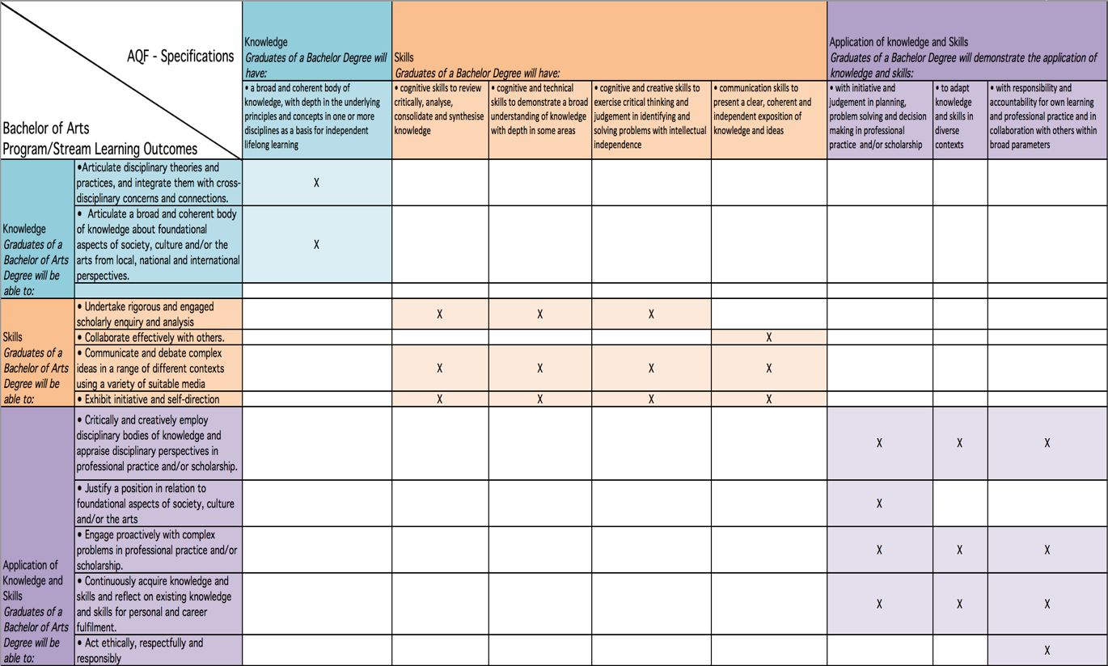
UNSW Mapping Tool
Australian Qualification Framework
(Australian F-10 Curriculum)
SC Activities
Some inspiration comes!
Source: UNSW, “Curriculum Mapping | UNSW Teaching Staff Gateway,” www.teaching.unsw.edu.au. https://www.teaching.unsw.edu.au/curriculum-mapping.

Slide 7
Science Island Mapping Logic
Part 1

Slide 8
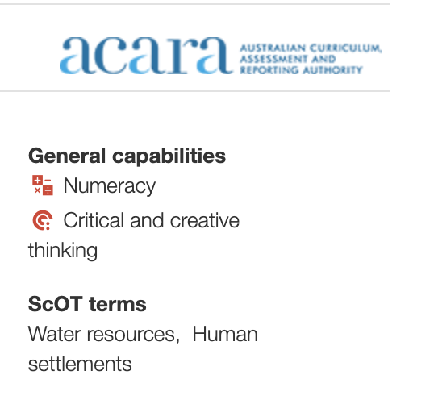
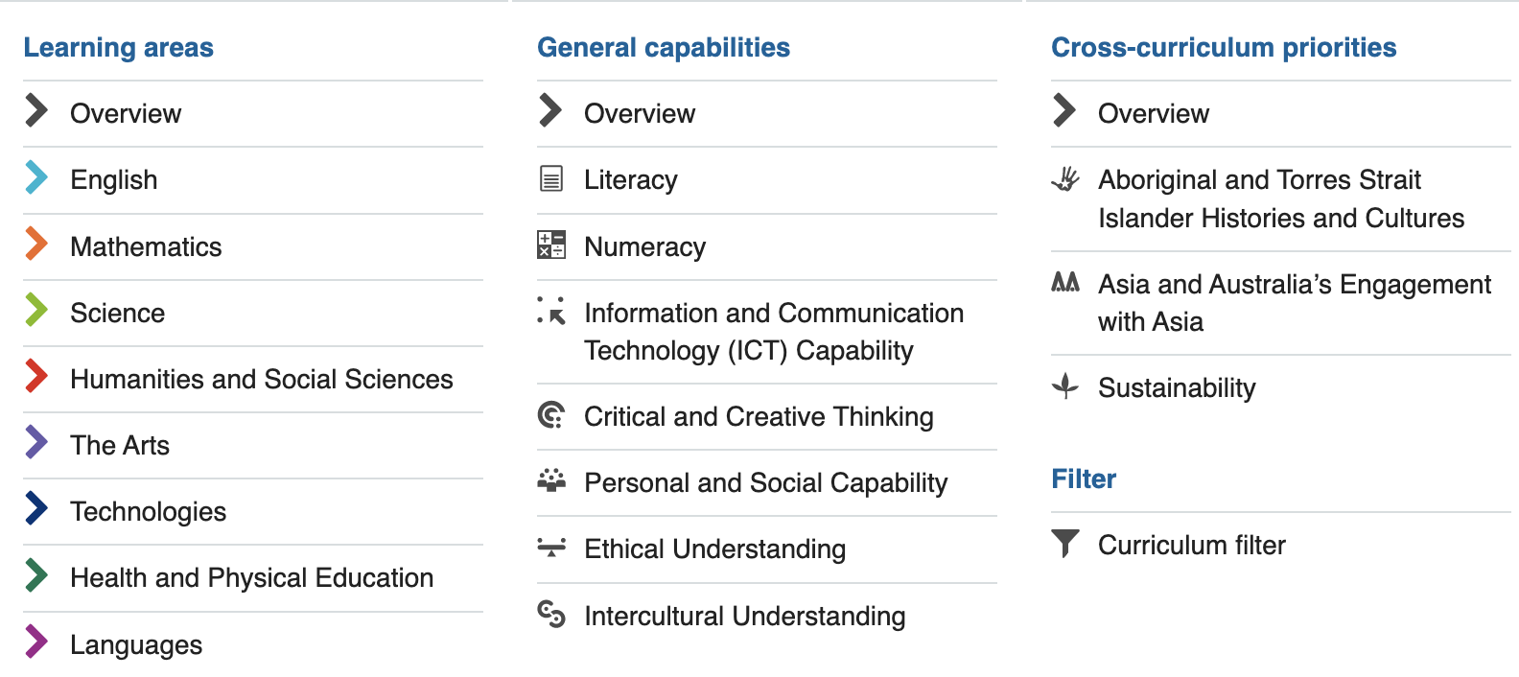
Australian F-10 Curriculum Structure
Only general capabilities shown in the detail page

Slide 9
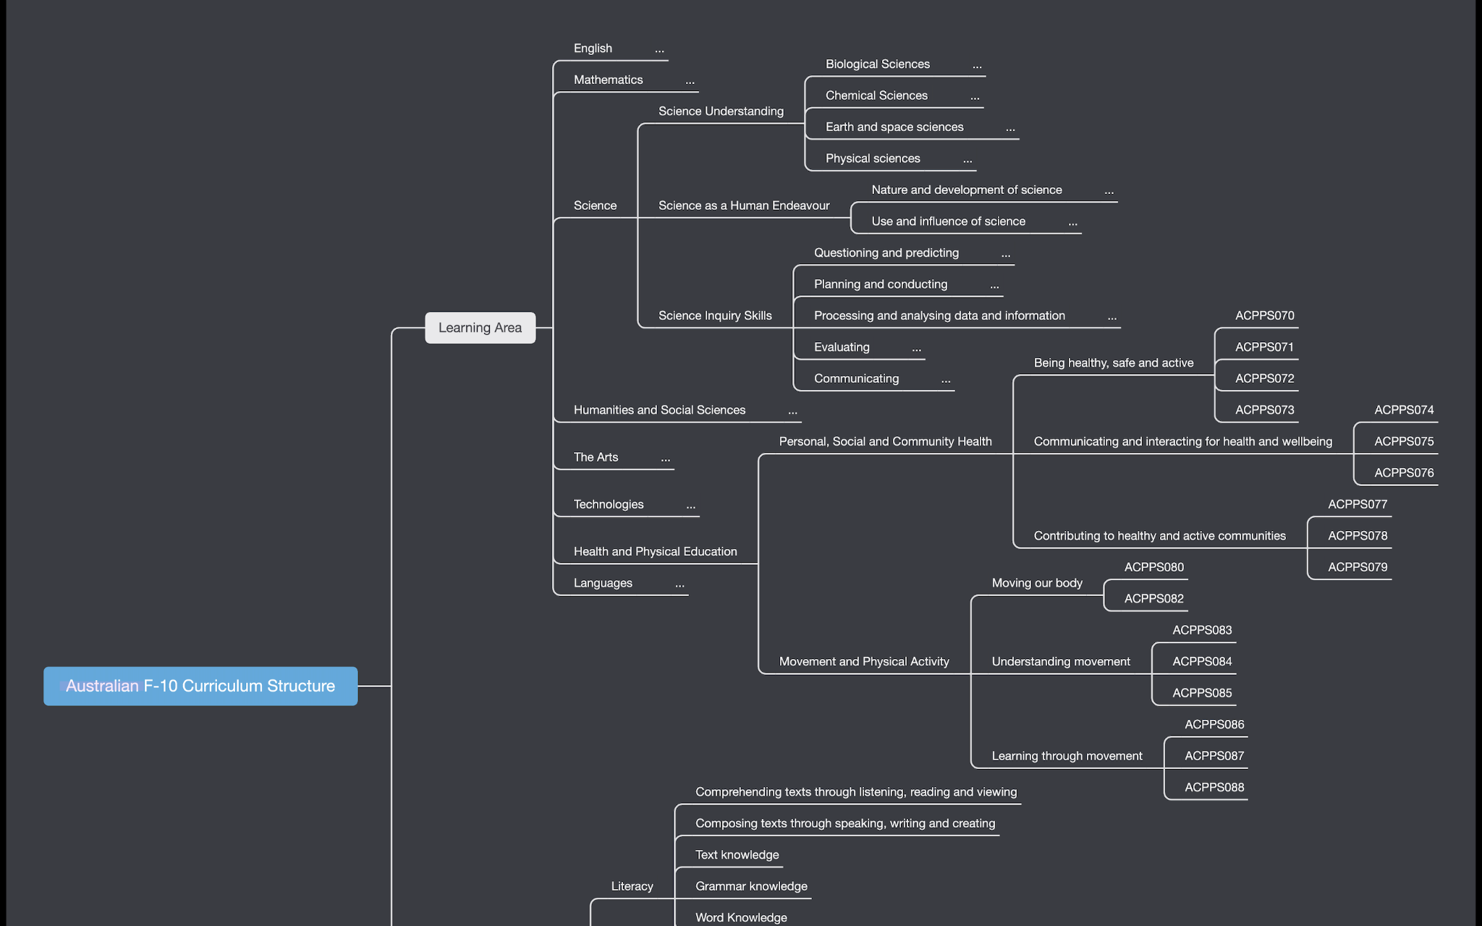

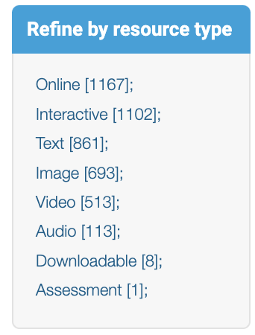
Australian F-10 Curriculum Structure (AC)
Map to
Year Level
Source
Subject Strand Substrand Code

Slide 10
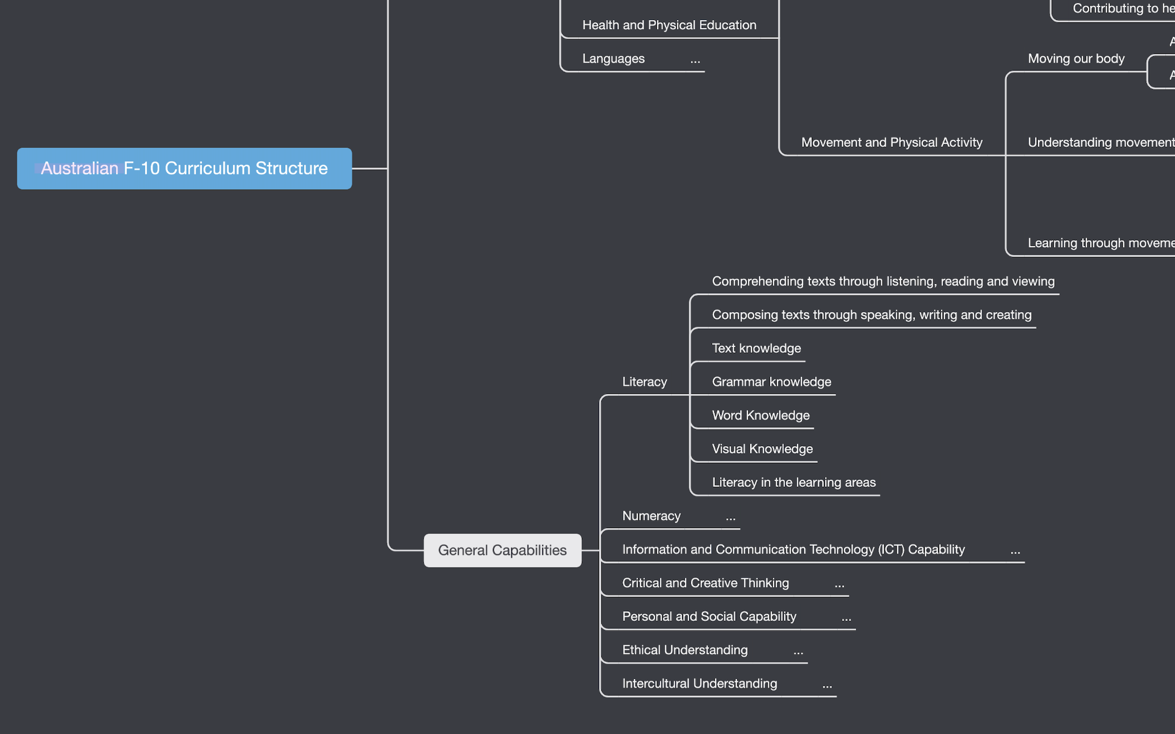
Australian F-10 Curriculum Structure (AC)
Map to

Slide 11

Australian F-10 Curriculum Structure
If we can get the API of AC website, the mapping can be automatically updated if some changes happened on the website side.
Otherwise the database is static. Once the website has been updated, the structure in our database would be updated manually

Slide 12
Other Mapping Software Examples
Part 1

Slide 13
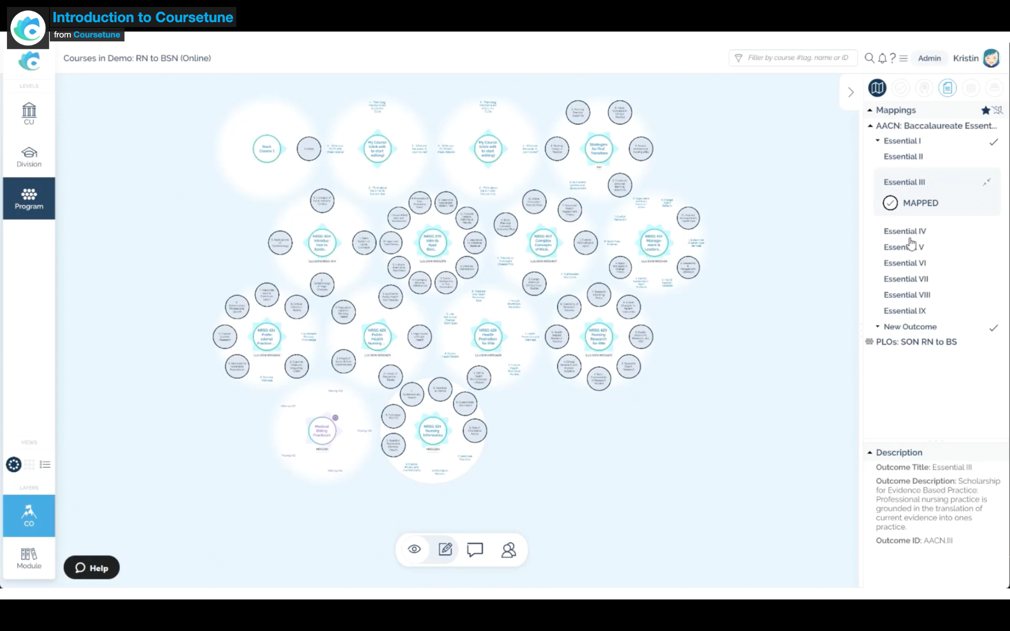
Coursetune
Half mapped
Fully mapped
Unmapped
Whole courses (Activities) view
Source: M. Andersen, “coursetune,” CourseTune, 2019. https://coursetune.com/.

Slide 14
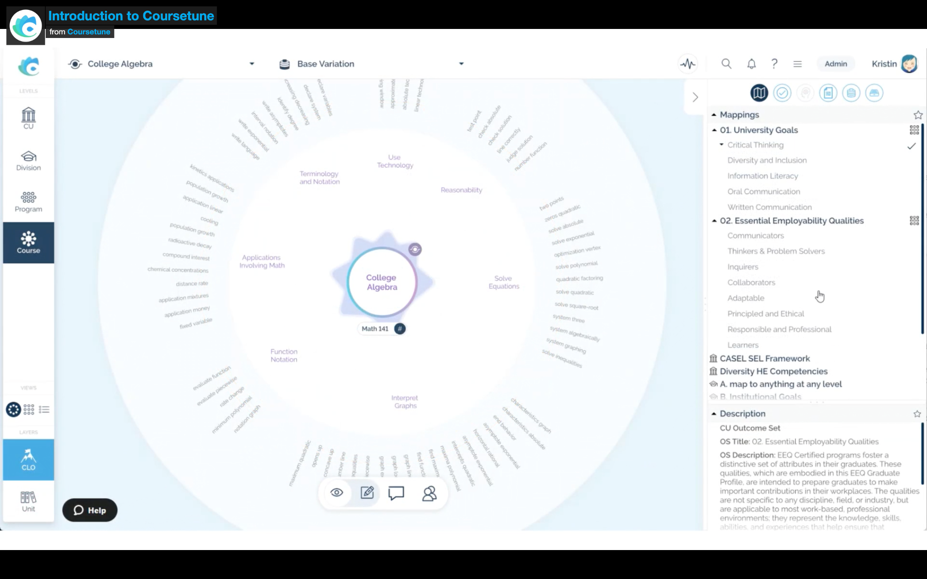
Coursetune
Gradient descend
Strand
Subject
Mapping setting view
Source: M. Andersen, “coursetune,” CourseTune, 2019. https://coursetune.com/.

Slide 15
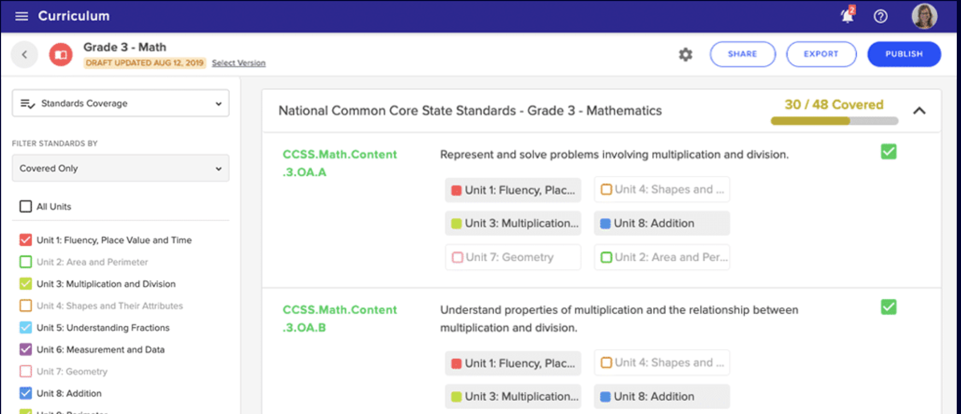
Chalk
Content with tag
Chalk, “Curriculum Mapping and Lesson Planning Software,” Chalk, Jun. 16, 2021. https://www.chalk.com/schools/ (accessed Mar. 21, 2022).

Slide 16
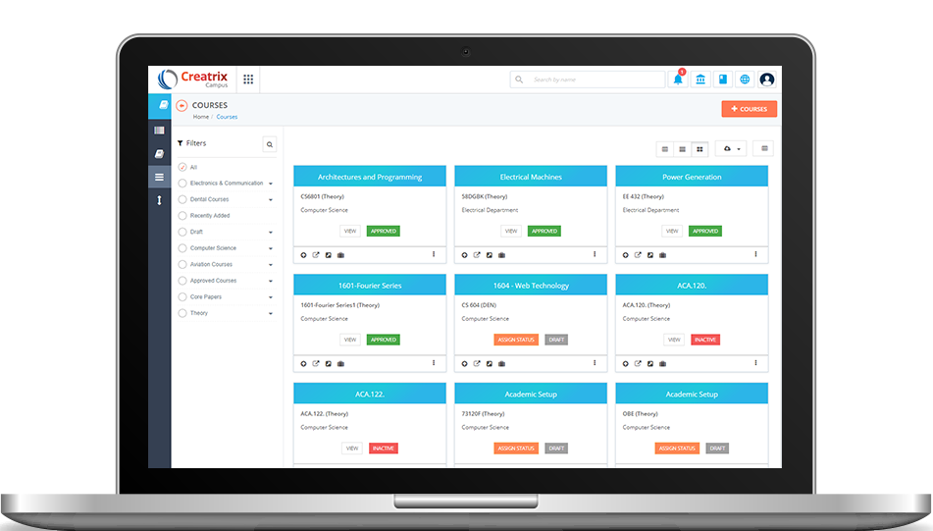
Ceatrix
Content with tag
Ceatrix, “The Powerful Curriculum Management System to efficiently plan and manage your courses.,” www.creatrixcampus.com. https://www.creatrixcampus.com/curriculum-management-software (accessed Mar. 21, 2022).

Slide 17
Science Island Mapping Software Prototype
Part 1

Slide 18
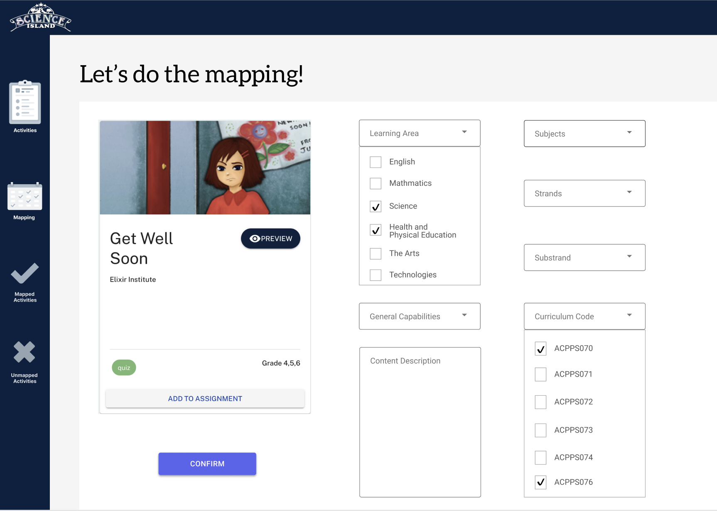
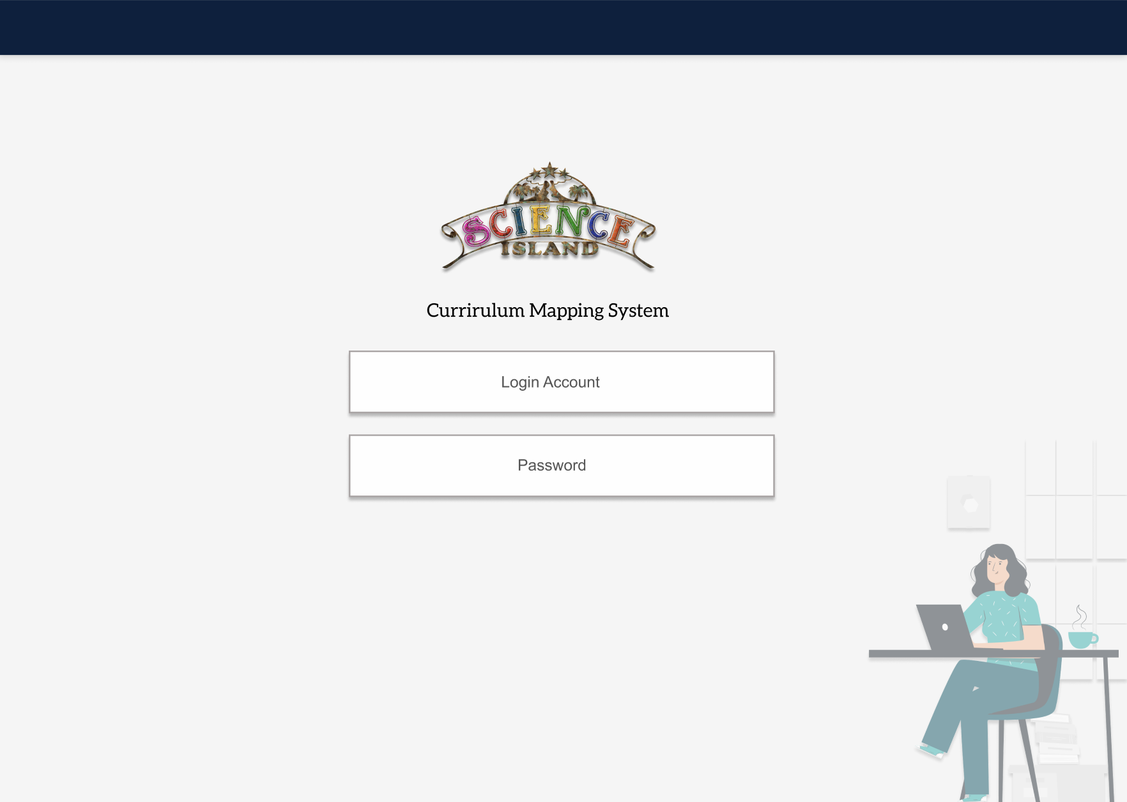
Prototype

Slide 19
Assignment Section Extension
Part 1

Slide 20
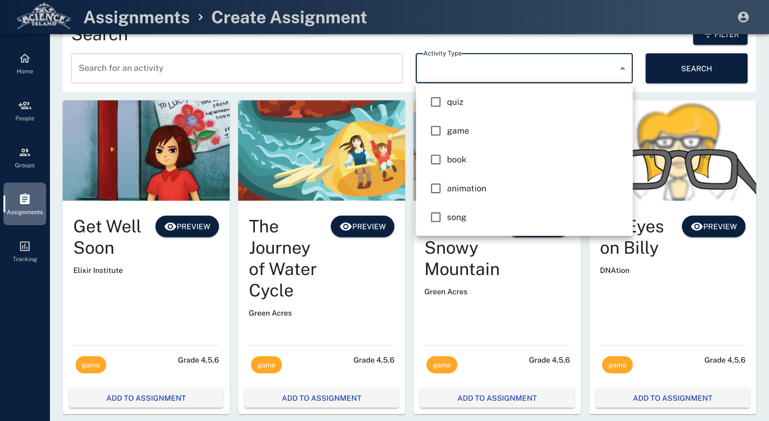
New tags should be shown up
Add new filter window with the corresponding type, i.e.
Subject -
Strand -
Substrand -
Code -
Year -
Learning Area -
……
Health & PE

Slide 21
Requirement Analysis (User stories)
Part 2

Slide 22
User (Case) Stories
Epic | ID | As (role) | I want to (goal) | So that (benefit) | Priority
Mapping | 1 | Teacher/Admin | See all SC activities in one page | I can have an overview of all activities | Must Have
 | 2 | Teacher/Admin | Select one of the activities | I can map that activity to the corresponding curriculum | Must Have
 | 3 | Teacher/Admin | Map the activity based on the curriculum structure | I can map the activity in a hierarchical way | Must Have
 | 4 | Teacher/Admin | Map one activity to multiple tags of the same hierarchical level | I can have the mapping satisfying multiple subjects, strands, codes and so on | Must Have

Slide 23
User (Case) Stories
Epic | ID | As (role) | I want to (goal) | So that (benefit) | Priority
Mapping | 5 | Teacher/Admin | Map the activity with each possible category defined in AC | There is no missing tag for this particular activity | Must Have
 | 6 | Teacher/Admin | Have two separate sections showing mapped and unmapped activities | I can understand which activity has or has not been tagged | Must Have
 | 7 | Teacher/Admin | Enable this software applicable to other international curriculums | The activity can satisfy the requirement in other curriculums | Should Have

Slide 24
User (Case) Stories
Epic | ID | As (role) | I want to (goal) | So that (benefit) | Priority
Assignment Extension | 8 | Parent/Teacher | Filter the activities by newly-built tags | I can sort all activities based on the AC | Must Have
 | 9 | Parent/Teacher | See all the new tags with each activity | I know which AC category the activity is subject to | Must Have
 | 10 | Parent/Teacher | Creating the assignment with newly tagged activities | I can know what AC my kids are going to learn and would have a chance to meet the requirement when it is finished | Must Have

Slide 25
System User Analysis (Personas)
Part 2

Slide 26
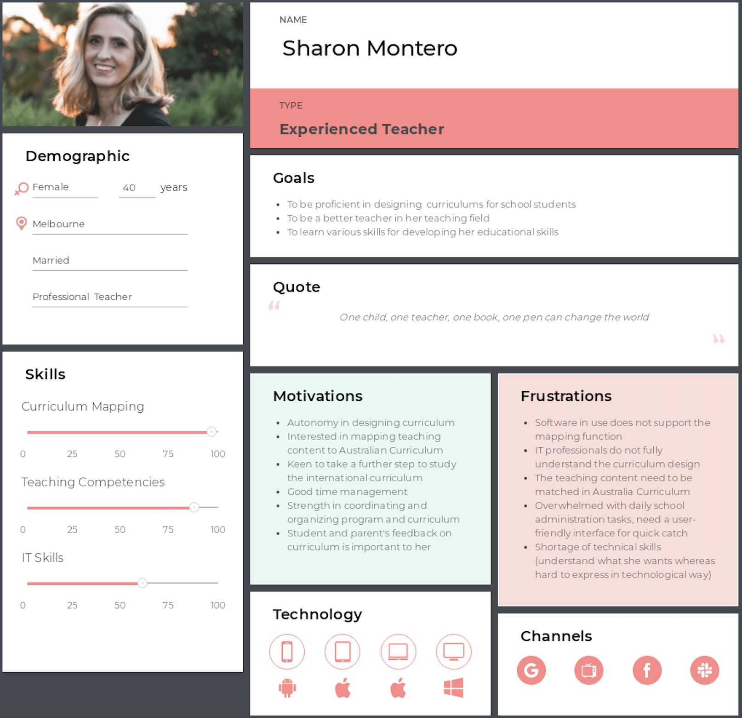
Curriculum Mapping
Software
Target User:
A small group of professionals (Teacher / Admin)

Slide 27
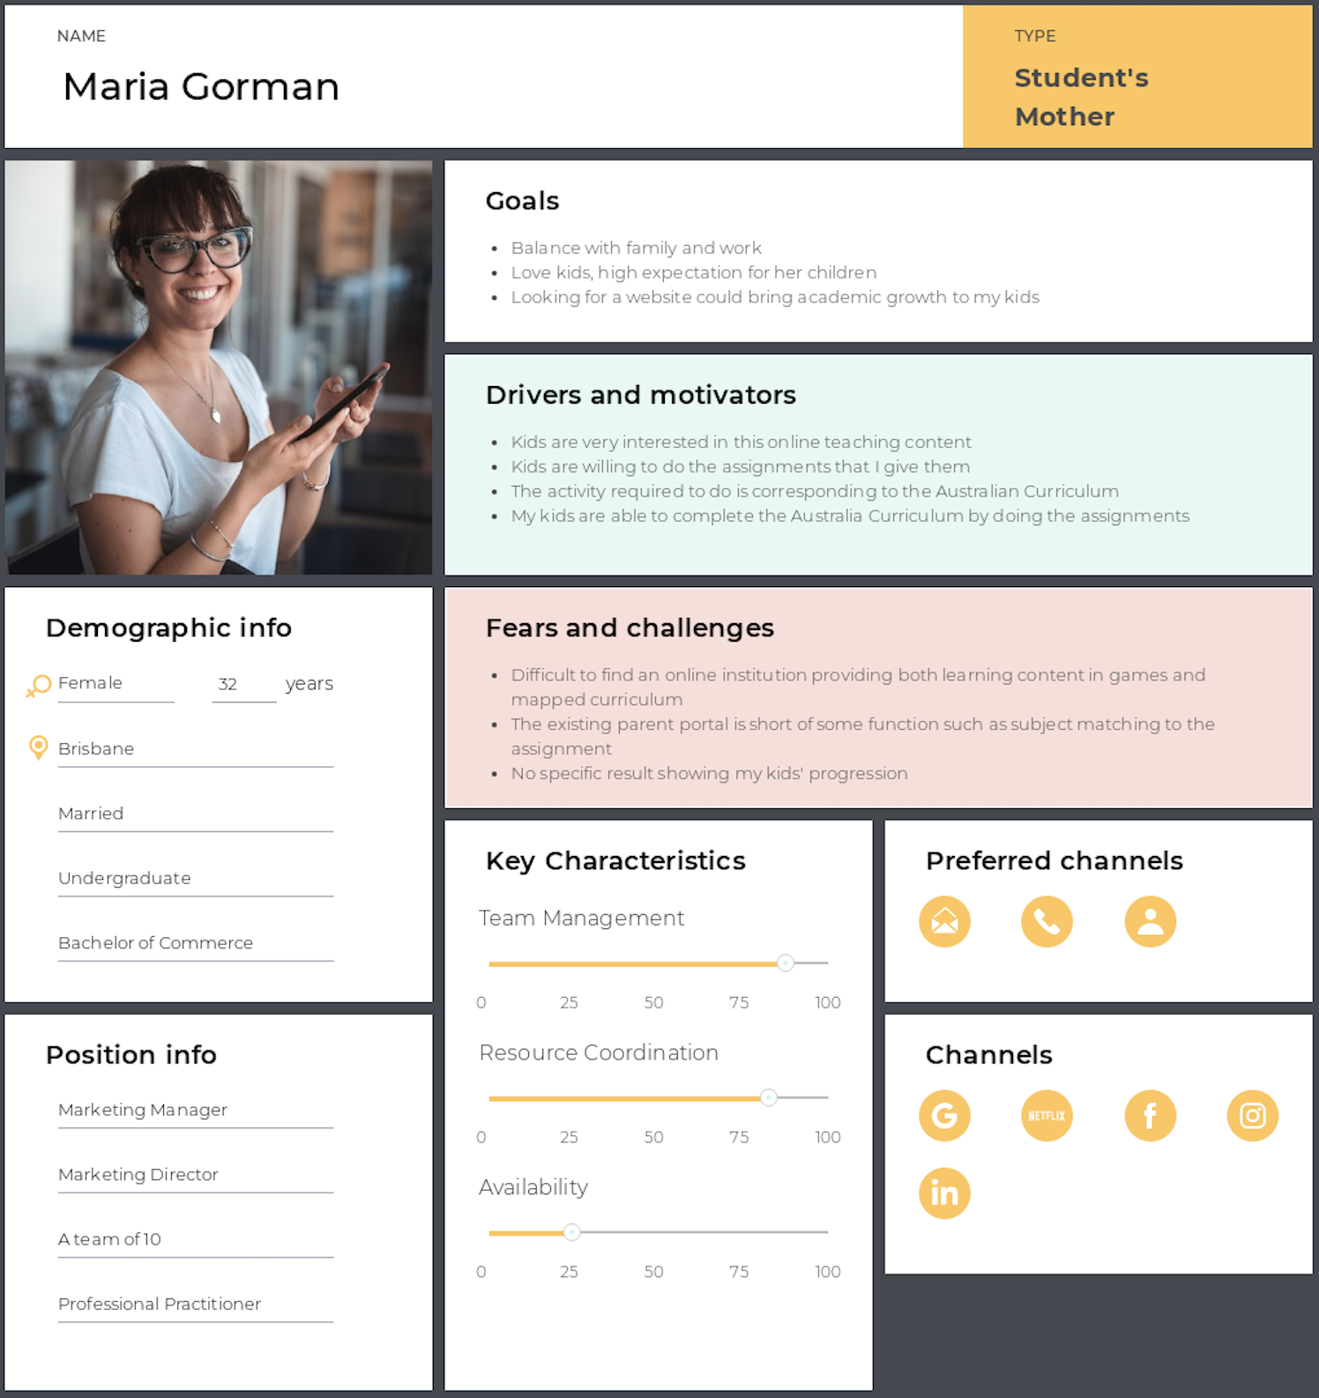
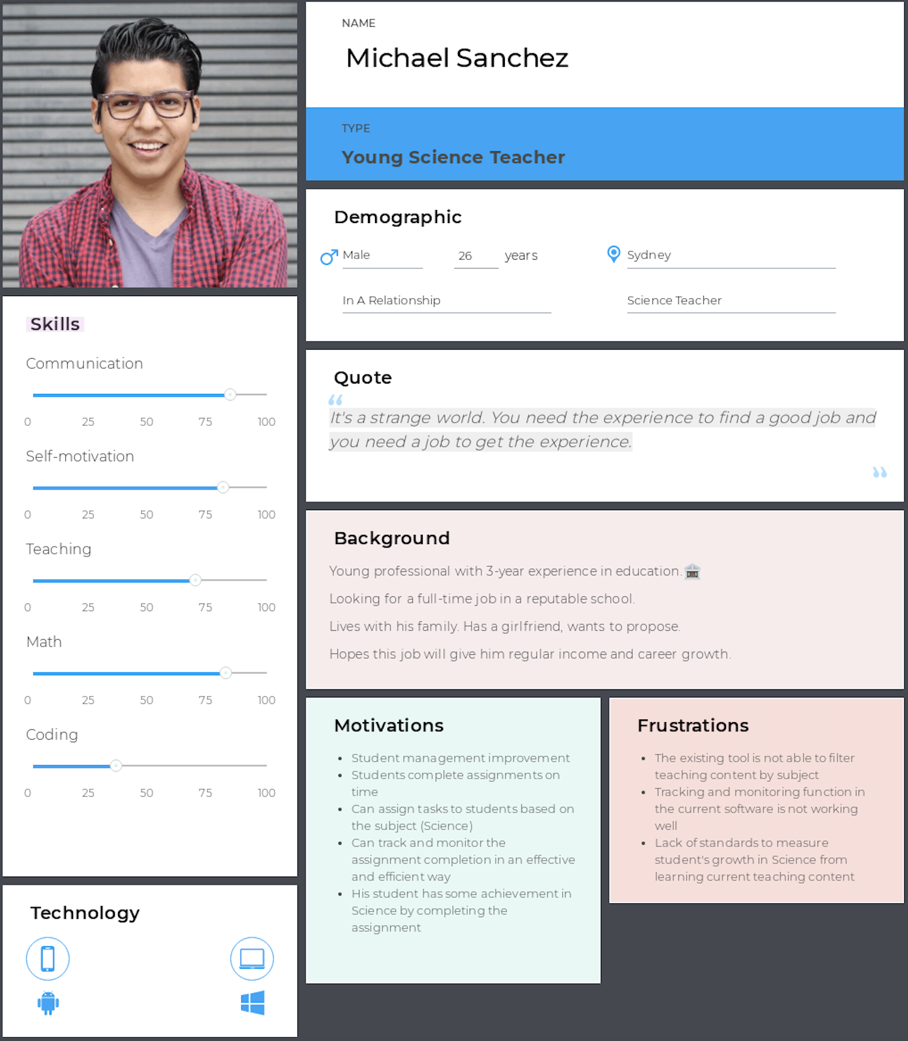
Teacher Portal
Target User:
The public user (Teacher/Parent/School)

Slide 28
Motivational Model (Who-Do-Be-Feel)
Part 2

Slide 29
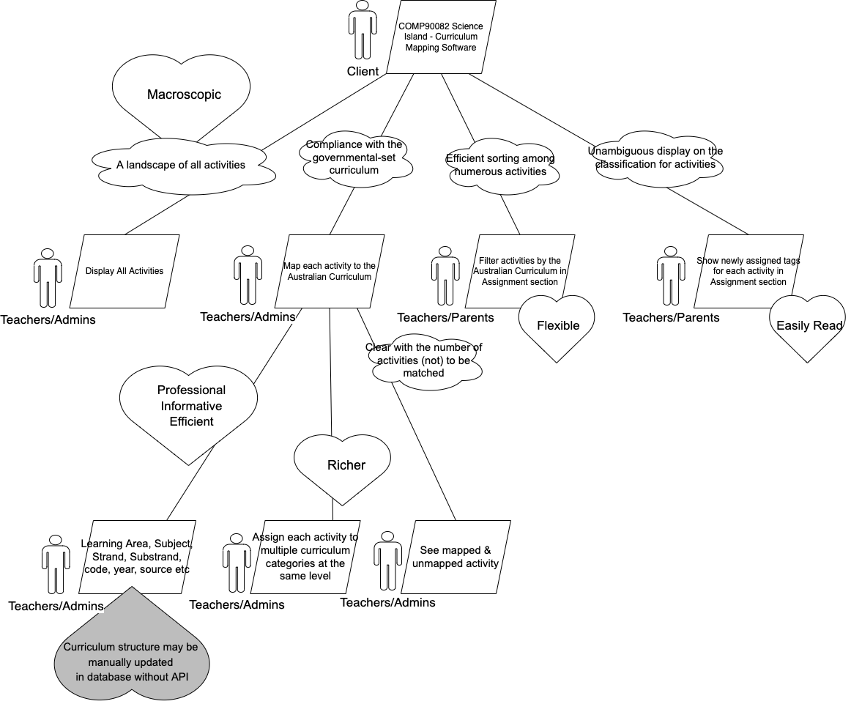
Motivational
Model

Slide 30
Thank you.

